Slide 1

Dr. Ammar Haider
Assistant Professor
School of Computing
CS3002 Information Security
Security in TCP/IP

Slide 2
Implementation options
Channel Security
Message/Data Security
Security internal to applications
Security external to applications

Slide 3
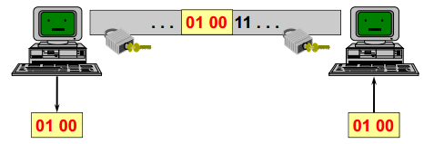
Channel Security
authentication, integrity and secrecy only during the transit inside the communication channel
requires no (or small) modification of applications

Slide 4
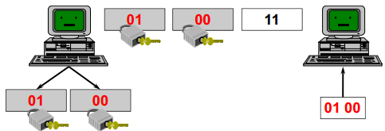
Message/data security
authentication, integrity and secrecy self contained in the message
requires modification of applications

Slide 5
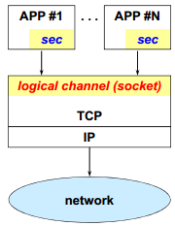
Security internal to applications
each application implements security internally
the common part is limited to the communication channels (socket)
possible implementation errors (inventing security protocols is not simple!)
does not guarantee interoperability

Slide 6
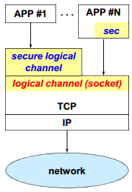
Security external to applications
the session level would be the ideal one to be used to implement many security functions
… but it does not exist in TCP/IP!
a “secure session” level was proposed:
it simplifies the work of application developers
it avoids implementation errors
it is up to the application to use it (or not)

Slide 7
Transport Layer Security (TLS)
formerly called
Secure Sockets Layer (SSL)

Slide 8
SSL/TLS Timeline
SSL was a commercial protocol, it evolved into TLS, an IETF standard.
Version | Published | Deprecated
SSL 1.0 | Never published
SSL 2.0 | 1995 | 2011
SSL 3.0 | 1996 | 2015
TLS 1.0 | 1999 | 2021
TLS 1.1 | 2006 | 2021
TLS 1.2 | 2008 | in use
TLS 1.3 | 2018 | in use
now considered insecure, should no longer be used

Slide 9
SSL: what is it?
Secure Sockets Layer: Security between layer 4 (transport) and layer 5
Provides a secure transport channel for:
peer authentication (server only, or server + client)
message confidentiality
message authentication and integrity
protection against replay attacks
Easily applicable to all protocols based on TCP
HTTP, SMTP, FTP, Telnet, ...
e.g. the famous secure HTTP (https://....) = 443/TCP

Slide 10
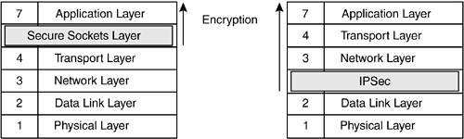
SSL: what is it?
Philosophy: Easier to deploy something if no changes in OS required
Socket API provide an interface for SSL
hence called secure socket layer
SSL sockets API is the superset of plain TCP sockets API
SSL/TLS operate above TCP.
OS doesn’t change, applications do!

Slide 11
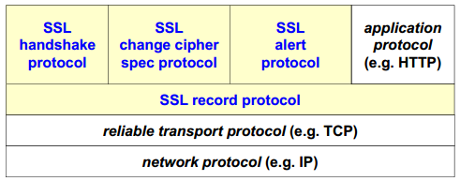
SSL/TLS Protocol Stack
Handshake: enables the client and server to negotiate cipher algorithms and establish the secret keys with which they will communicate
Change-cipher-spec: indicates the confirmation of secret key usage for data communication
Alert: signal problems with SSL connection, give current status
Record protocol: securely carries the data of higher layers
Notes:
I am done with the unencrypted setup phase, and all my future messages will be encrypted using the new secret keys we just agreed upon

Slide 12
SSL/TLS Handshake
agree on a set of algorithms for confidentiality, integrity and authentication
exchange random numbers between the client and the server to be used for the subsequent generation of the keys
establish a symmetric key by means of public key (asymmetric crypto) operations, e.g. RSA, Diffie Hellman
negotiate the session-id
exchange the necessary certificates

Slide 13



Handshake in brief
Hello: ciphers I support, R_{client}
Hello: certificate, cipher I choose, R_{server}
Securely exchange, or establish pre-master secret S
Derive master key
K = f (S, R_{client}, R_{server})
Derive master key
K = f (S, R_{client}, R_{server})
Verify master key and Finish
Verify master key and Finish
Data protected by keys derived from K
Secrets are: Pre-master secret S, Master Key K
Server authentication via certificate, client authentication optional

Slide 14
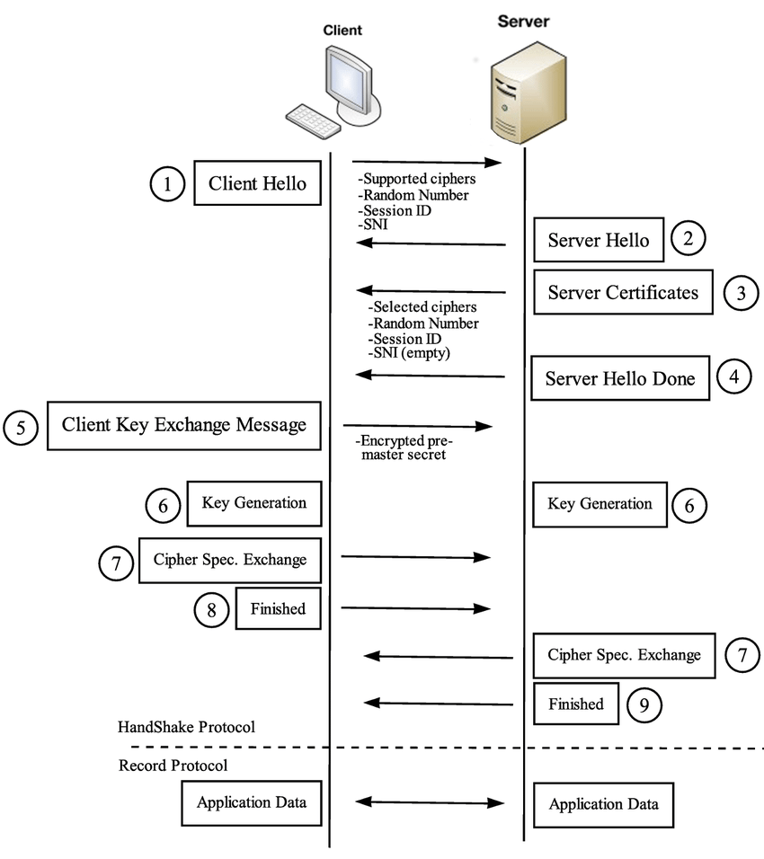
Handshake in detail
Notes:
SNI(Server Name indication

Slide 15
Handshake in detail

Slide 16
Key Handshake Terms
HELLO Extensions: request extended functionality by sending data in the extensions field.
e.g. max_fragment_length, status request
The server may not oblige
Client may abort the handshake
Pre-master secret, S:
EITHER generated by client and sent to server using RSA encryption
OR derived via a key exchange algorithm e.g. Diffie Hellman (g^{ab} mod p)

Slide 17
Key Handshake Terms
Master key: generated by applying a Pseudo-Random Function (PRF).
Master key = PRF(S, R_{client}, R_{server})
Master key may also be the called the session key.
Subsequently, multiple cryptographic operations (like encryption and MAC calculation) will be applied on the application data. Keys for all these operations are derived from the session key.

Slide 18
Pre-Master vs Master
Why not use pre-master secret (S) as the session key?
There are various reasons, but most importantly, it is for prevention of replay attacks.
An attacker could intercept client’s packets, record them, and send to server again at a later time.
Server needs to be able to detect such attempts.
Including unique random values from both parties (R_{client}, R_{server}) helps prevent these attacks.
Even if an attacker intercepts and tries to reuse a valid handshake request, the server’s random values in a new session would be different.
https://security.stackexchange.com/q/218491/245722

Slide 19
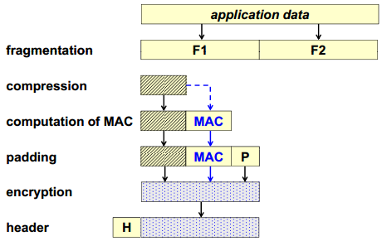
SSL/TLS record protocol

Slide 20
MAC computation
MAC = message_digest ( key, seq_number | type | version | length | fragment )
message_digest: the chosen hash algorithm
key: sender-write-key or receiver-read-key
seq_number: 32-bit integer
type: type of record
change cipher spec (20)
alert (21)
handshake (22)
application data (23)
length: length of the fragment/plaintext
Notes:
Fragment: the application data or any record type data that you want to send

Slide 21
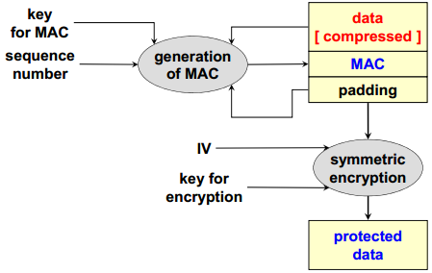
Record Protocol Workflow

Slide 22
TLS 1.3 important changes
Removed unnecessary features like compression
Removed ability to ‘renegotiate’ cipher specs
Removed broken hash functions like MD5 and SHA‑224
Mandated Diffie-Hellman for key exchange (replacing RSA) in order to ensure forward secrecy
Reordered and merged handshake messages for a faster negotiation.
Whole handshake can be completed in 1 round trip.
Notes:
Done before encryption: means compression is done before encryption. Doing compression after encryption is useless because encryption makes data completely random.

Slide 23
Internet Protocol Security (IPsec)

Slide 24
IPsec
Security at layer 3
IPsec ensures:
confidentiality, integrity, and authenticity
Allows secure communication on the Internet
Independent from the application or higher protocols
Network-layer security instead of application-layer security
Compatible with schemes providing security at the application layer (can be applied simultaneously)

Slide 25
IPsec
Philosophy: implementing security within the operating systems automatically causes all applications to be protected without changing applications
IPsec is within the OS.
OS changes, applications and API to TCP don’t.

Slide 26
IPsec
Further advantages:
Can be applied to all network traffic
Routers/firewalls vendors can implement it (can't implement SSL)
Transparent to the applications
Transparent to the users
Limitations:
Limited to IP addresses
Has no concept of application users

Slide 27
Applications of IPsec
Secure connection among different branches of the same company
Virtual Private Network (VPN)
Secure remote access to an Intranet through the (insecure) Internet
Allows secure remote workers
Secure communication between peers
Secure inter-organizational communication
such as between customers and vendors/suppliers
Notes:
it can encrypt and/or authenticate all traffic at the IP level. Thus, all distributed applications, including remote logon, client/server, e-mail, file transfer, Web access, and so on, can be secured

Slide 28
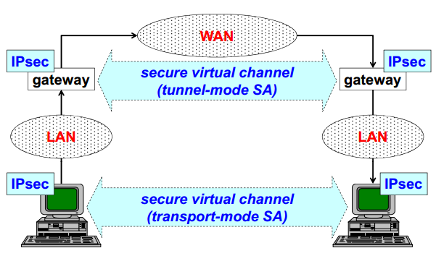
IPsec operating modes

Slide 29
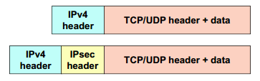

Transport mode
used for end-to-end security, that is used by hosts, not gateways
exception: traffic for the gateway itself e.g. SNMP, ICMP
pro: computationally light
con: no protection of header fields

Slide 30
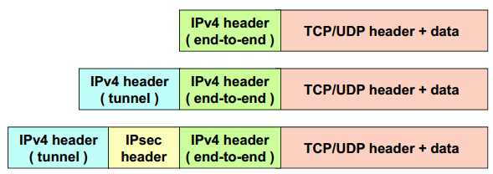
Tunnel Mode
used to create a VPN, usually by gateways
gateway-to-gateway mode
pro: protection of header variable fields
con: computationally heavy
Notes:
End-to-end: this is the original IP header

Slide 31
IPsec protocol suite
IPsec standard defines three distinct protocols:
definition of two specific packet types:
Authentication Header (AH)
for integrity, authentication and anti-replay
Encapsulating Security Payload (ESP)
for confidentiality, integrity, authentication & anti-replay
protocol for key exchange:
Internet Key Exchange (IKE)
manages secure key exchange using public key algorithms and digital certificates
Notes:
IPSec is not preinstalled on the operating systems. Source code of OS must be changed to implement it. See Wikipedia page for details.

Slide 32
Security Policies
Rules to decide if an IP packet needs to be processed and how.
A policy defines
packet selection rules like source, destination
action to take (encrypt, authenticate, block)
IPsec protocol (ESP/AH) and mode (transport/tunnel)
e.g. all outbound packets from database server (say 192.168.5.1) to clients subnet (e.g. 192.168.12.0/24) should be authenticated by AH in transport mode
all traffic going to remote gateway (say 170.34.12.6) should be encrypted with ESP in tunnel mode

Slide 33
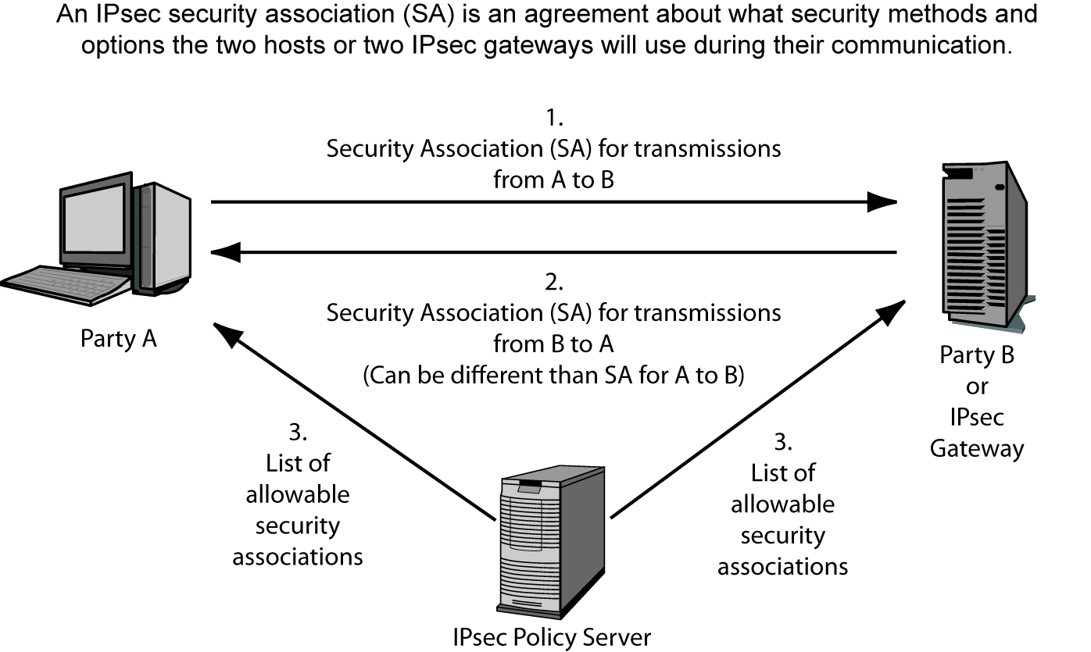
IPsec Security Associations

Slide 34
IPSEC (Internet Protocol Security)
When a device receives a packet via the IPSec protocol, it is the SA that tells the device what to do with the packet. So if device B receives a packet from device C via IPSec, device B will look to the corresponding SA to tell it how to decrypt the packet, how to properly authenticate the source of the packet, which key to use, and how to reply to the message if necessary.
SAs are directional, so a device will have one SA for outbound traffic and a different SA for inbound traffic for each individual communication channel. If a device is connecting to three devices, it will have at least six SAs, one for each inbound and outbound connection per remote device.

Slide 35
IPSEC (Internet Protocol Security)
So how can a device keep all of these SAs organized and ensure that the right SA is invoked for the right connection? With the mighty security parameter index (SPI), that’s how.
Each device has an SPI that keeps track of the different SAs and tells the device which one is appropriate to invoke for the different packets it receives. The SPI value is in the header of an IPSec packet, and the device reads this value to tell it which SA to consult, as depicted in the Figure.

Slide 36
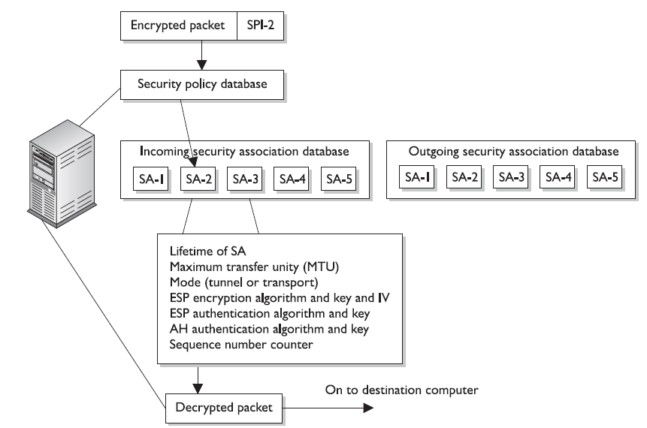

Slide 37

Security Associations
A contract between two peers on security parameters (like keys, cipher algorithms, key expiry)
Separate associations in each direction
two SA are needed to get complete protection of a bidirectional packet flow in IPsec
Three SA identification parameters
Security parameter index (SPI)
IP destination address
IPsec protocol (AH or ESP)
Notes:
"Security Association" is the big name for whatever a machine A needs to know in order to send IPSec-protected packets to a machine B. Within the memory of A is the information: "with B, packets must use this type of IPSec header (AH or ESP) with these cryptographic algorithms and that specific key". By definition, when machine A talks to machine B and uses IPSec for such communication, then there must be some convention between A and B about how this will be done. "Security Association" is the defined terminology to describe that convention. How a security association is established is another matter -- it can be manual configuration by sysadmins on both machines, or done dynamically with a protocol such as ISAKMP
SPI: Uniquely identifies the SA between two parties.
Security protocol identifier: This indicates whether the association is an AH or ESP security association.

Slide 38
IPsec local databases
SAD (SA Database)
list of active SA and their characteristics
maintained by user-processes
SPD (Security Policy Database)
list of security policies to apply to the different packet flows
a-priori configured (e.g. manually) or connected to an automatic system (e.g. ISPS: Internet Security Policy System)
Notes:
Manual configuration by sysadmins on both pcs that are communicating using IPSec.
A security policy is used by the SAD to indicate what the router should do with the packet. Three examples include dropping the packet altogether, dropping only the SA, or substituting a different SA. All of the security policies in use are stored in a security policy database

Slide 39
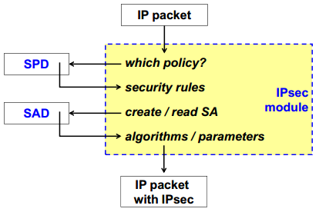
How IPsec works (sending)

Slide 40
Authentication Header (AH)
first version mechanism (RFC-1826):
data integrity and sender authentication
compulsory support of keyed-MD5 (RFC-1828)
optional support of keyed-SHA1 (RFC-1852)
second version mechanism (RFC-2402):
data integrity, sender authentication and protection from replay attack
HMAC-MD5
HMAC-SHA-1

Slide 41
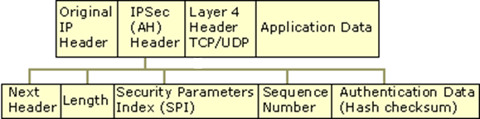
AH packet: header structure
Next header: identifies the nature of the payload (TCP/UDP)
Length: Indicates the length of the AH header
SPI: Identifies the correct security association for the communication
Sequence Number: Provides anti-replay protection for the SA
Auth. Data: contains the Integrity Check Value (ICV) that is used to verify the integrity of the message. The receiver calculates the hash value and checks it against this value (calculated by the sender) to verify integrity.

Slide 42
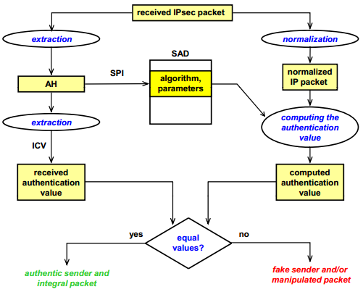
AH verification (receiving)
Notes:
By "normalizing" these fields, AH ensures that the integrity check only fails if the protected parts of the packet (source/destination IPs, payload, etc.) have been tampered with, and not because of standard network operations.
Traffic normalizer: normalizes traffic in such a way that Network Intrusion Detection Systems(NIDS) are able to avoid penetrations by attackers by exploiting the ambiguities in the traffic stream as seen by the monitor. E.g: packet maybe fragmented by the attacker so that its reassembled at the user end by evading through the NIDS.
https://users.ece.cmu.edu/~vsekar/Teaching/Spring18/18731/reading/NIDS_Handley.pdf
Network Intrusion Detection: Evasion, Traffic Normalization, and End-to-End Protocol Semantics Mark Handley and Vern Paxson

Slide 43
Encapsulating Security Payload (ESP)
first version (RFC-1827) included confidentiality only
base mechanism: DES-CBC (RFC-1829)
second version (RFC-2406)
provides confidentiality & authentication (but not the IP header, so the coverage is not equivalent to that of AH)

Slide 44
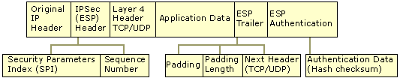
ESP header structure
SPI, Sequence number, Next header: same fields as in AH
Auth. Data: Contains the Integrity Check Value (ICV), which is a message authentication code used to verify the sender's identity and message integrity. The ICV is calculated over the ESP header, the payload data and the ESP trailer
Initialization Vector (IV): optional. After the sequence number

Slide 45
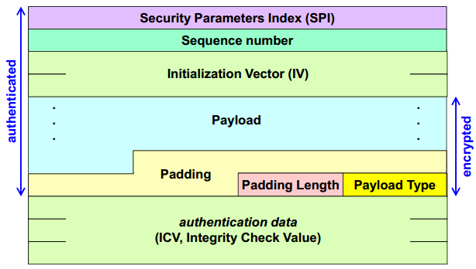
ESP Packet: Encryption & Authentication
aka Next header

Slide 46
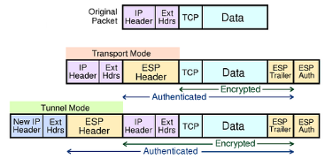
ESP in transport mode
the payload is hidden (including info needed for QoS or intrusion detection)
the header remains in clear

Slide 47
ESP in tunnel mode
hides both the payload and (original) header
con: larger packet size

Slide 48
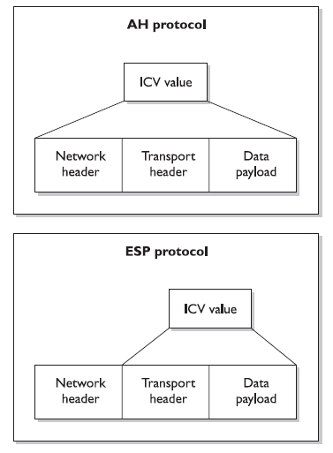
AH and ESP use
different portions
of the packet to
calculate the ICVs.

Slide 49
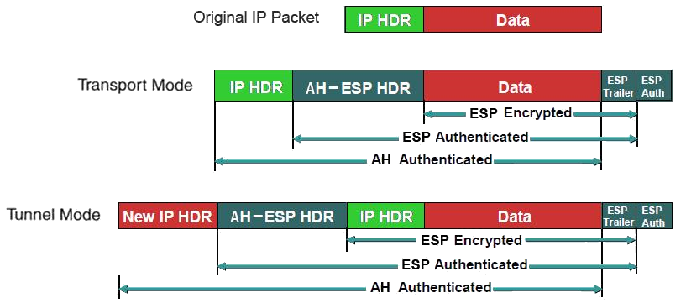
Comparing AH & ESP coverage

Slide 50
References
Stallings SPP chap 22
TLS Handshake analysis in Wireshark: https://www.youtube.com/watch?v=MQg48n9lV0s
Comic Explanation of TLS Handshake: https://howhttps.works/the-handshake/
illustrated TLS connection – every byte explained and reproduced: TLS 1.2 and TLS 1.3
IPsec lecture by Forida State Uni
IBM reference for IPsec AH and ESP protocols

